Slide 1
Testing of Hypothesis
By: Basharat Mahmood
Department of Computer Science,
COMSATS University Islamabad, Pakistan.

Slide 2
Outline
Introduction to testing of hypothesis
Testing of Hypothesis about Population Mean
Testing of Hypothesis about Two Population Means
Testing of Hypothesis about Population Proportion

Slide 3
1. Introduction to testing of hypothesis
Often, the problem confronting the scientist or engineer is not the estimation of a population parameter, but rather the formation of a data-based decision procedure that can produce a conclusion about some scientiﬁc system
a medical researcher may decide on the basis of experimental evidence whether coﬀee drinking increases the risk of cancer in humans
an engineer might have to decide on the basis of sample data whether there is a diﬀerence between the accuracy of two kinds of gauges

Slide 4
1. Introduction to testing of hypothesis …
The field of statistical inference consists of those methods used to make decisions or draw conclusions about a population
These methods utilize the information contained in a sample from the population in drawing conclusions

Slide 5
1. Introduction to testing of hypothesis …
A statistical hypothesis is an assertion or conjecture concerning one or more populations
we take a random sample from the population of interest
use the data contained in this sample to provide evidence that either supports or does not support the hypothesis
rejection of a hypothesis implies that the sample evidence refutes it

Slide 6
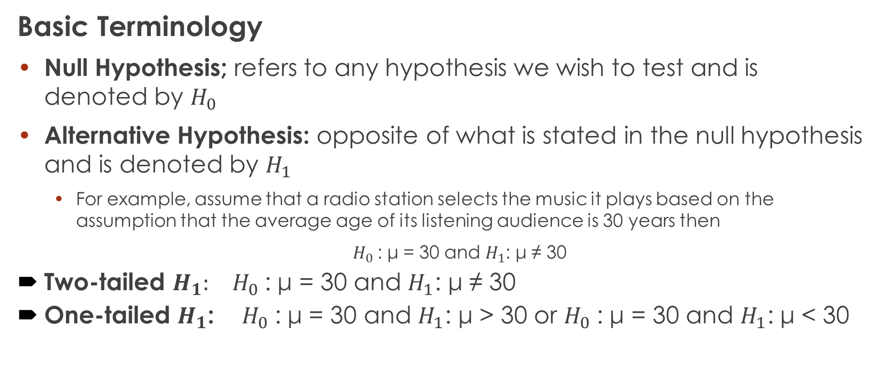
1. Introduction to testing of hypothesis …
Basic Terminology
Null Hypothesis; refers to any hypothesis we wish to test and is denoted by $H_{0}$
Alternative Hypothesis: opposite of what is stated in the null hypothesis and is denoted by $H_{1}$
For example, assume that a radio station selects the music it plays based on the assumption that the average age of its listening audience is 30 years then
$H_{0}$: μ = 30 and $H_{1}$: μ ≠ 30
Two-tailed $H_{1}:$ $H_{0}$: μ = 30 and $H_{1}$: μ ≠ 30
One-tailed $H_{1}$: $H_{0}$: μ = 30 and $H_{1}$: μ > 30 or $H_{0}$: μ = 30 and $H_{1}$: μ < 30

Slide 7
1. Introduction to testing of hypothesis …
Basic Terminology
Type I Error: Occurs if the null hypothesis is rejected when it is in fact true.
The probability of type I error ( α ) is also called the level of significance.
Type II Error: Occurs if the null hypothesis is not rejected when it is in fact false.
The probability of type II error is denoted by β

Slide 8
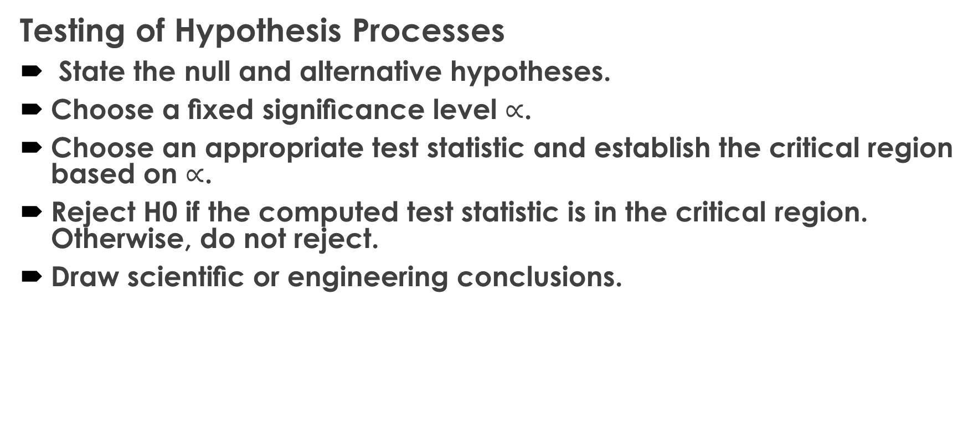
1. Introduction to testing of hypothesis …
Testing of Hypothesis Processes
State the null and alternative hypotheses.
Choose a ﬁxed signiﬁcance level $∝$.
Choose an appropriate test statistic and establish the critical region based on $∝$.
Reject H0 if the computed test statistic is in the critical region. Otherwise, do not reject.
Draw scientiﬁc or engineering conclusions.

Slide 9
1. Introduction to testing of hypothesis …
Testing of Hypothesis (p-value approach)
State null and alternative hypotheses.
Choose an appropriate test statistic.
Compute the P-value based on the computed value of the test statistic.
Use judgment based on the P-value

Slide 10
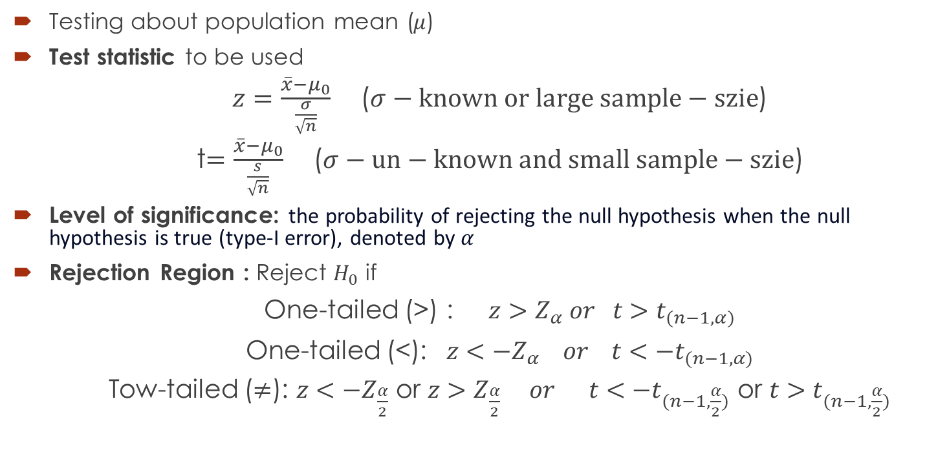
2. Testing of Hypothesis about Population Mean
Testing about population mean ($μ$)
Test statistic to be used
$z=\frac{\overline{x}−μ_{0}}{\frac{σ}{\sqrt{n}}}$ ($σ−known or large sample−szie$)
t$=\frac{\overline{x}−μ_{0}}{\frac{s}{\sqrt{n}}}$ ($σ−un−known and small sample−szie$)
Level of significance: the probability of rejecting the null hypothesis when the null hypothesis is true (type-I error), denoted by $α$
Rejection Region : Reject $H_{0}$ if
One-tailed (>) : $z>Z_{α} or t>t_{(n−1,α)}$
One-tailed (<): $z<−Z_{α} or t<−t_{(n−1,α)}$
Tow-tailed ($≠$): $z<−Z_{\frac{α}{2}}$ or $z>Z_{\frac{α}{2}} or t<−t_{(n−1,\frac{α}{2})} \text{or} t>t_{(n−1,\frac{α}{2})}$

Slide 11
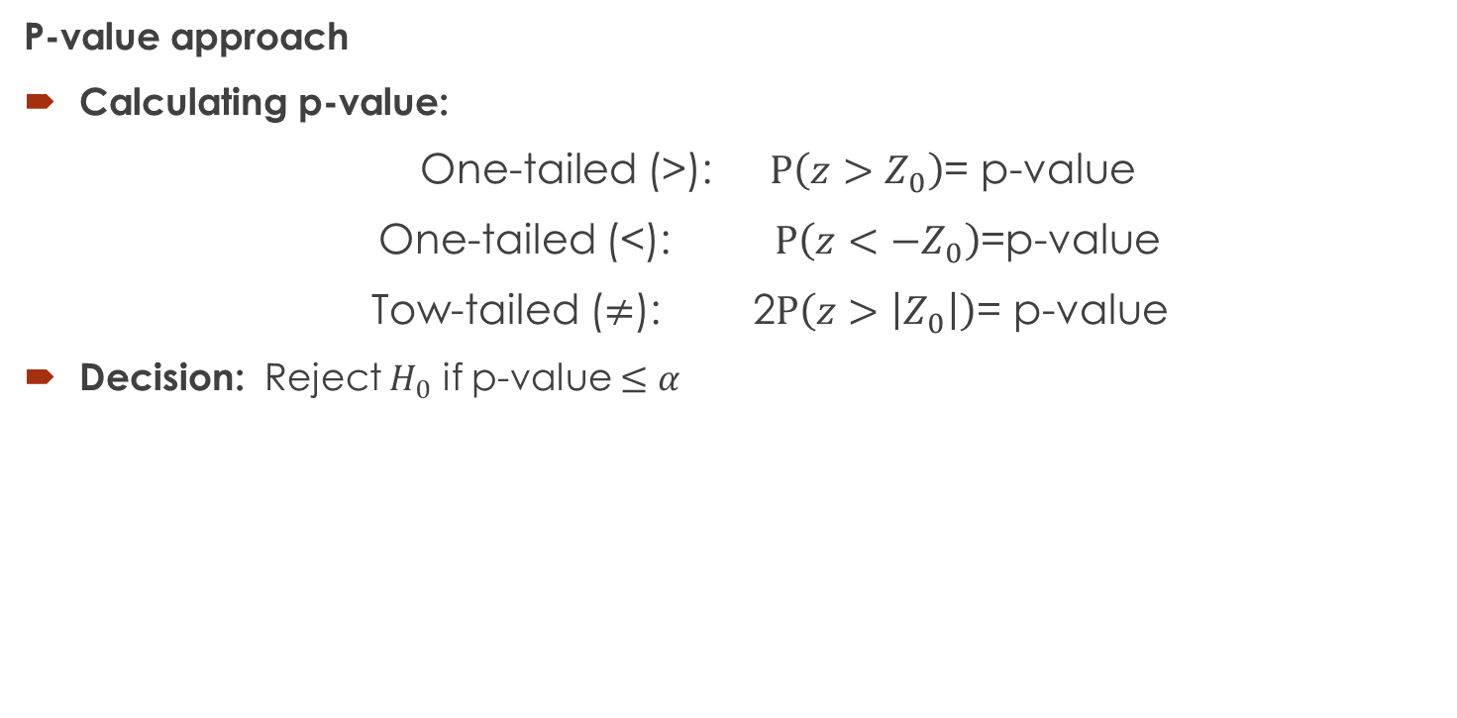
2. Testing of Hypothesis about Population Mean …
P-value approach
Calculating p-value:
One-tailed (>): $P\left(z>Z_{0}\right)$= p-value
One-tailed (<): $P\left(z<−Z_{0}\right)$=p-value
Tow-tailed ($≠$): 2$P\left(z>\left|Z_{0}\right|\right)$= p-value
Decision: Reject $H_{0}$ if p-value $≤α$

Slide 12
2. Testing of Hypothesis about Population Mean …
Example 1: In a research report, Richard H. Weindruch of the UCLA Medical School claims that mice with an average life span of 32 months will live to be about 40 months old when 40% of the calories in their diet are replaced by vitamins and protein. Is there any reason to believe that μ<40 if 64 mice that are placed on this diet have an average life of 38 months with a standard deviation of 5.8 months?

Slide 13

2. Testing of Hypothesis about Population Mean …
Example 2: Does the evidence support the idea that the average lecture consists of 3000 words if a random sample of the lectures of 16 professors had a mean of 3472 words, given the population standard deviation is 500 words? Use $α$ = 0.01. Assume that lecture lengths are approximately normally distributed.

Slide 14
2. Testing of Hypothesis about Population Mean …
Example 3: The Edison Electric Institute has published ﬁgures on the number of kilowatt hours used annually by various home appliances. It is claimed that a vacuum cleaner uses an average of 46 kilowatt hours per year. If a random sample of 12 homes included in a planned study indicates that vacuum cleaners use an average of 42 kilowatt hours per year with a standard deviation of 11.9 kilowatt hours, does this suggest at the 0.05 level of signiﬁcance that vacuum cleaners use, on average, less than 46 kilowatt hours annually? Assume the population of kilowatt hours to be normal.

Slide 15

3. Testing of Hypothesis about Two Population Means
Test statistic to be used
$z=\frac{\left({\overline{x}}_{1}−{\overline{x}}_{2}\right)−\left(μ_{1}−μ_{2}\right)}{\sqrt{\frac{σ_{1}^{2}}{n_{1}}+\frac{σ_{2}^{2}}{n_{2}}}}$ $(σ_{1},σ_{2}−known$)
$z=\frac{\left({\overline{x}}_{1}−{\overline{x}}_{2}\right)−\left(μ_{1}−μ_{2}\right)}{σ\sqrt{\frac{1}{n_{1}}+\frac{1}{n_{2}}}}$ ($σ_{1},σ_{2}−known and{ σ}_{1}=σ_{2}=σ$)
t$=\frac{\left({\overline{x}}_{1}−{\overline{x}}_{2}\right)−\left(μ_{1}−μ_{2}\right)}{s_{p}\sqrt{\frac{1}{n_{1}}+\frac{1}{n_{2}}}}$ ($σ_{1},σ_{2}−unknown but{ σ}_{1}=σ_{2}$)
$s_{p}=\sqrt{\frac{\left(n_{1}−1\right)s_{1}^{2}+\left(n_{2}−1\right)s_{2}^{2}}{n_{1}+n_{2}−2}}$
and
${df=n}_{1}+n_{2}−2$

Slide 16

3. Testing of Hypothesis about Two Population Means …
Test statistic to be used
t$=\frac{\left({\overline{x}}_{1}−{\overline{x}}_{2}\right)−\left(μ_{1}−μ_{2}\right)}{\sqrt{\frac{s_{1}^{2}}{n_{1}}+\frac{s_{2}^{2}}{n_{2}}}}$ ($σ_{1},σ_{2}−unknown but{ σ}_{1}≠σ_{2}$)
$df= \frac{{\left(\frac{s_{1}^{2}}{n_{1}}+\frac{s_{2}^{2}}{n_{2}}\right)}^{2}}{\left[\frac{{\left(\frac{s_{1}^{2}}{n_{1}}\right)}^{2}}{n_{1}−1}\right]+\left[\frac{{\left(\frac{s_{2}^{2}}{n_{2}}\right)}^{2}}{n_{2}−1}\right]}$
t$=\frac{\overline{d}−d_{0}}{\frac{s_{d}}{\sqrt{n}}}$ ($paired observations$)
$s_{d}=\sqrt{\frac{n\sum{d_{i}^{2}}−{\left(\sum{d_{i}}\right)}^{2}}{n\left(n−1\right)}}$

Slide 17

3. Testing of Hypothesis about Two Population Means …
Example 4: A random sample of size n1 = 25, taken from a normal population with a standard deviation σ1 =5 .2, has a mean ${\overline{X}}_{1}$ = 81. A second random sample of size n2 = 36, taken from a diﬀerent normal population with a standard deviation σ2 =3 .4, has a mean ${\overline{X}}_{2}$ = 76. Test the hypothesis that μ1 = μ2 against the alternative, μ1 $≠$ μ2.

Slide 18
3. Testing of Hypothesis about Two Population Means …
Example 5: A manufacturer claims that the average tensile strength of thread A exceeds the average tensile strength of thread B by at least 12 kilograms. To test this claim, 50 pieces of each type of thread were tested under similar conditions. Type A thread had an average tensile strength of 86.7 kilograms with a standard deviation of 6.28 kilograms, while type B thread had an average tensile strength of 77.8 kilograms with a standard deviation of 5.61 kilograms. Test the manufacturer’s claim using a 0.05 level of signiﬁcance.

Slide 19
3. Testing of Hypothesis about Two Population Means …
Example 6: A study was conducted to see if increasing the substrate concentration has an appreciable eﬀect on the velocity of a chemical reaction. With a substrate concentration of 1.5 moles per liter, the reaction was run 15 times, with an average velocity of 7.5 micromoles per 30 minutes and a standard deviation of 1.5. With a substrate concentration of 2.0 moles per liter, 12 runs were made, yielding an average velocity of 8.8 micromoles per 30 minutes and a sample standard deviation of 1.2. Is there any reason to believe that this increase in substrate concentration causes an increase in the mean velocity of the reaction of more than 0.5 micromole per 30 minutes? Use a 0.01 level of signiﬁcance and assume the populations to be approximately normally distributed with equal variances.

Slide 20
3. Testing of Hypothesis about Two Population Means …
Example 7: Five samples of a ferrous-type substance were used to determine if there is a diﬀerence between a laboratory chemical analysis and an X-ray ﬂuorescence analysis of the iron content. Each sample was split into two subsamples and the two types of analysis were applied. Following are the coded data showing the iron content analysis:
Sample
Analysis 1 2 3 4 5
X-ray 2.0 2.0 2.3 2.1 2.4
Chemical 2.2 1.9 2.5 2.3 2.4
Assuming that the populations are normal, test at the 0.05 level of signiﬁcance whether the two methods of analysis give, on the average, the same result.

Slide 21
4. Testing of Hypothesis about Population Proportion
Applicable to situations that do not ask for the mean but rather to know what percentage of the population is in favour of a certain idea or concept such as:
Will a new product be a success or not?
Will this certain candidate win or not?

Slide 22

4. Testing of Hypothesis about Population Proportion
Test-statistic to be used
Binomial variable X with p = p0 (preferably, when sample size is small)
P = P(X ≤ x when p = p0) (H1: <)
P = P(X ≥ x when p = p0) (H1: >)
P =2P(X ≤ x when p = p0) if x < npo (H1: $≠$)
P =2P(X ≥ x when p = p0) if x > npo (H1: $≠$)
When sample size is large i.e., np₀(1 – p₀) ≥ 10

Slide 23
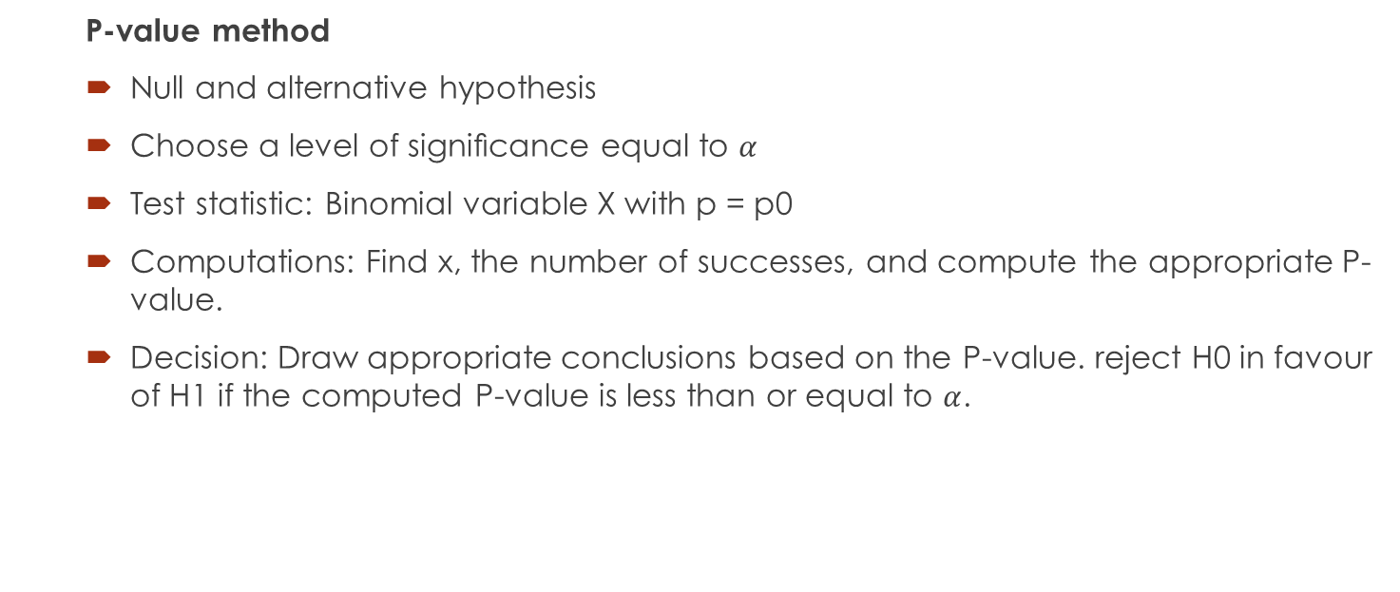
4. Testing of Hypothesis about Population Proportion…
P-value method
Null and alternative hypothesis
Choose a level of signiﬁcance equal to $α$
Test statistic: Binomial variable X with p = p0
Computations: Find x, the number of successes, and compute the appropriate P-value.
Decision: Draw appropriate conclusions based on the P-value. reject H0 in favour of H1 if the computed P-value is less than or equal to $α$.

Slide 24
4. Testing of Hypothesis about Population Proportion…
Example 8: In 1997, 46% of Americans said they did not trust the media “when it comes to reporting the news fully, accurately and fairly”. In a 2007 poll of 1010 adults nationwide, 525 stated they did not trust the media. At the α = 0.05 level of significance, is there evidence to support the claim that the percentage of Americans that do not trust the media to report fully and accurately has increased since 1997?

Slide 25
4. Testing of Hypothesis about Population Proportion…
Example 9: A builder claims that heat pumps are installed in 70% of all homes being constructed today in the city of Richmond, Virginia. Would you agree with this claim if a random survey of new homes in this city showed that 8 out of 15 had heat pumps installed? Use a 0.10 level of signiﬁcance.

Slide 26

4. Testing of Hypothesis about Population Proportion: Two Populations
Test-statistic to be used:
for large sample size

Slide 27
4. Testing of Hypothesis about Population Proportion: Two Populations
Example 10: A vote is to be taken among the residents of a town and the surrounding county to determine whether a proposed chemical plant should be constructed. The construction site is within the town limits, and for this reason many voters in the county believe that the proposal will pass because of the large proportion of town voters who favour the construction. To determine if there is a signiﬁcant diﬀerence in the proportions of town voters and county voters favouring the proposal, a poll is taken. If 120 of 200 town voters favour the proposal and 240 of 500 county residents favour it, would you agree that the proportion of town voters favouring the proposal is higher than the proportion of county voters? Use an α =0 .05 level of signiﬁcance.

Slide 28
References
Chapter 10, Introduction to statistics, Ronald E. Walpole.

